Slide 1
Presentation Video URL
{ https://youtu.be/w_LNSfbbPdQ?si=4OD57K7YVHSZfAat }

Slide 2

Concrete Architecture of GNUstep
PRESENTED BY
🟩 Daniel & Mohamed (Group Leader ) – Explanations of architecture
derivation process & Lessons learned.
🟪 Mirwais _Descriptions of top-level concrete subsystems and their
Interactions.
🟨 David _Detailed explanations of the inner architecture of one
subsystem and its interactions.
🟥 Musdaf & Mohanad (presenters) _Detailed investigations of the
discrepancies between the conceptual and concrete architecture in the
assigned subsystems & Sequence Diagrams.

Slide 3
Overview:
Introduction: Brief explanation of GNUstep framework and our analysis goals.
Architecture & Key Libraries: Overview of GNUstep’s hybrid layered and object-oriented architecture, highlighting core components and dependencies.
Use Cases: Real-world scenarios demonstrating interactions such as user interface events and GUI initialization.
Subsystem Analysis: Detailed look at libs-gui and its Model-View-Controller (MVC) structure, emphasizing indirect communication patterns.
Limitations & Lessons Learned: Challenges faced during analysis, impacts of architectural discrepancies, and key lessons learned.
Conclusion: Summary of key findings and insights, emphasizing practical implications for software design.

Slide 4
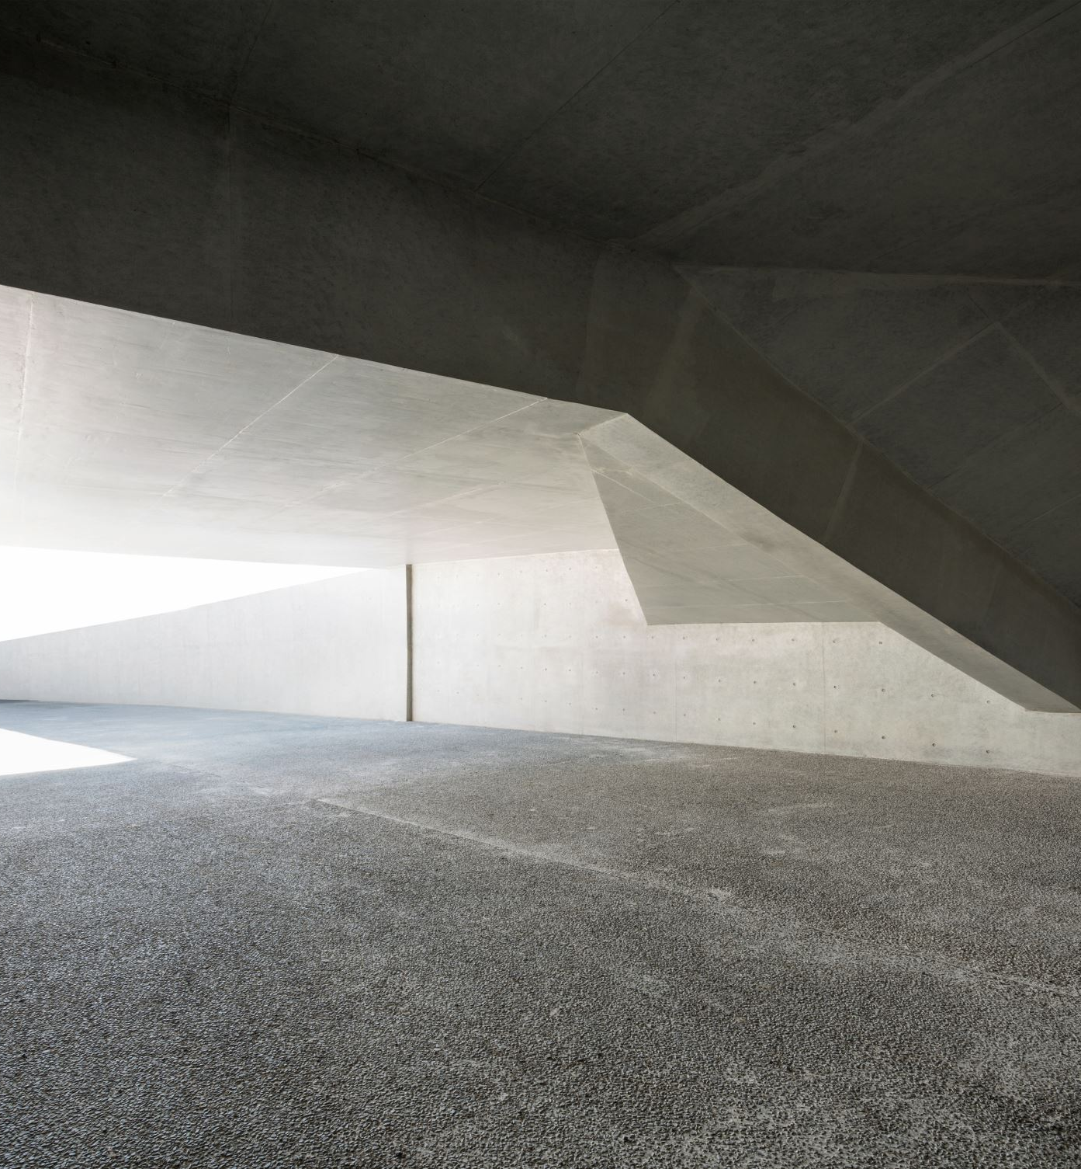
Introduction
This presentation explores the concrete architecture of the GNUstep framework by comparing it to its initial conceptual design. Utilizing a hybrid layered and object-oriented approach, we identify key discrepancies, including bidirectional dependencies, the explicit role of libobjc2, and shifts from direct to indirect communication patterns. Our analysis reveals practical implications such as performance optimizations and enhanced system flexibility, emphasizing the importance of iterative and adaptable architectural practices.

Slide 5
Conceptual vs Concrete Architecture
Conceptual: strict three-layer separation.
Concrete: unexpected dependencies.
Based on a strict three-layer model:
GUI Layer → libs-gui, Gorm
Core and Utility Layer → libs-base, libs-corebase
System Abstraction Layer → libs-back, libobjc2
Unidirectional dependencies only
Each layer communicates only with the layer below.
Promotes modularity and separation of concerns.
Analysis via SciTools Understand revealed:
Bidirectional dependencies (e.g., libs-gui ↔ libs-back)
libobjc2 explicitly present and active in system interaction
libs-back plays a broader role than just rendering (e.g., event handling)
Cross-layer communication reflects real-world needs for performance and flexibility.

Slide 6
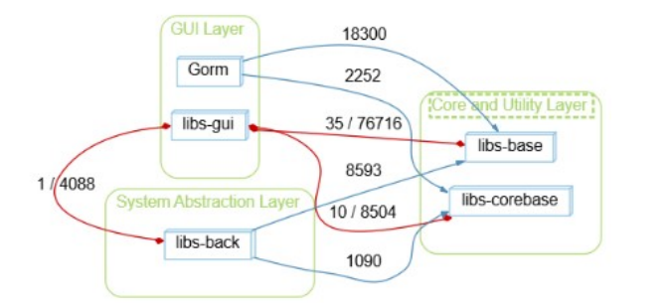
Top-Level Concrete Architecture
Core and Utility Layer:
libs-base: Provides essential functionalities (memory management, file handling).
Receives calls from Gorm and libs-back.
Interacts closely with libs-gui for UI-related operations.
libs-corebase: Offers CoreFoundation compatibility for cross-platform support.
Receives calls from Gorm and libs-back.
Communicates with libs-gui for UI state management.
GUI Layer:
Gorm: Graphical UI builder
Calls libs-base for initializing UI objects.
Calls libs-corebase for compatibility support.
libs-gui: Manages graphical elements and user interactions.
Depends on libs-back for platform-specific display support.
Utilizes libs-corebase features for interface logic
System Abstraction Layer:
libs-back: Manages platform-specific rendering and system interactions.
Communicates directly with libs-gui for event handling and rendering operations.
Calls libs-corebase to perform low-level system interactions.

Slide 7
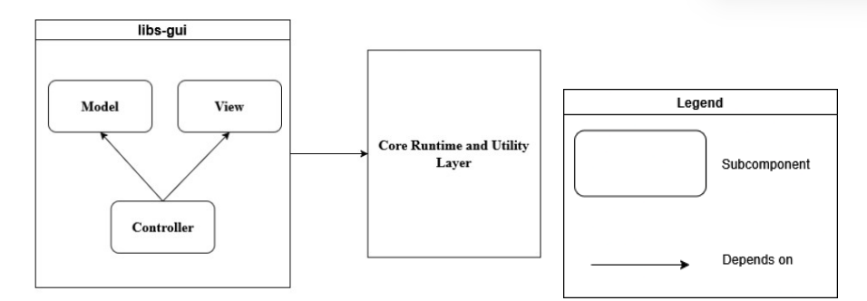
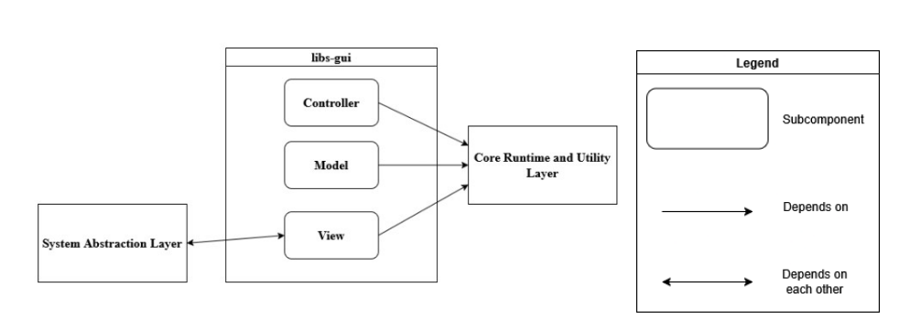
libs-gui Subsystem Analysis (MVC Breakdown)
Conceptual Architecture:
Follows the Model-View-Controller (MVC) design pattern.
Controller directly manages the Model and updates the View.
Assumes clear internal dependencies within libs-gui.
Concrete Findings:
No direct dependencies detected between Model, View, and Controller.
Communication handled indirectly using NSNotification and delegates.
Improves modularity but increases complexity in managing interactions.

Slide 8
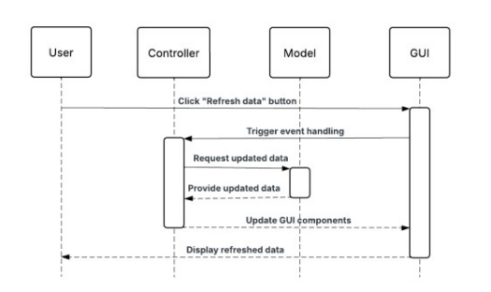
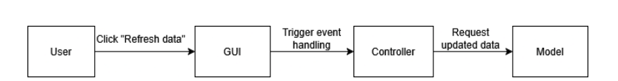
Use Case 1: GUI Interaction – Refresh Button
Scenario: User clicks a “Refresh Data” button in the GUI.
Step-by-step flow:
User clicks a button in the GUI (libs-gui).
libs-gui sends an event to the Controller.
Controller requests updated data from the Model.
Model sends new data back to the Controller.
Controller updates the View in libs-gui with the new data.

Slide 9
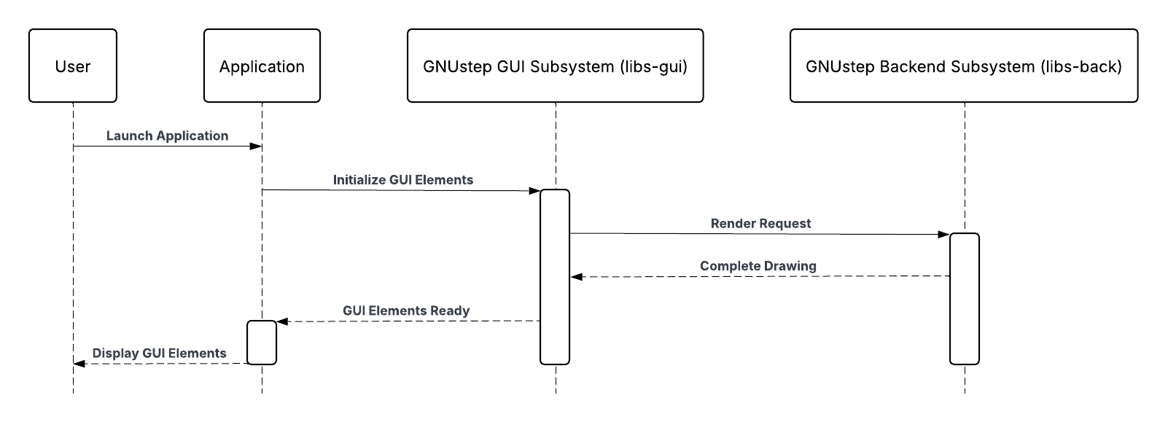
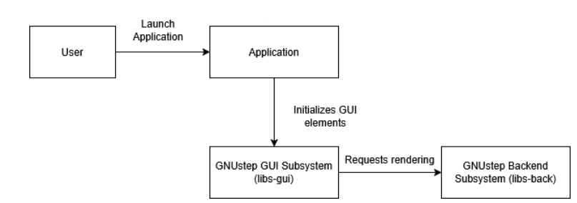
Use Case 2: Application Initialization
Scenario: User launches a GNUstep application.
Application starts and triggers the setup of GUI components via libs-gui.
libs-gui sends rendering requests to libs-back.
libs-back handles platform-specific drawing (e.g., for X11, Windows, etc.).
The GUI is displayed on screen with proper UI elements initialized and rendered.
Key Insight:
This sequence highlights how libs-gui and libs-back interact closely during application startup.

Slide 10

Lessons Learned from the Architecture Analysis
Iterative Design is Essential:
Our architecture evolved through multiple versions based on feedback and findings.
Initial ideas often required rethinking as our understanding deepened.
Conceptual vs Concrete Clarity:
Conceptual models are idealized and simplified.
Concrete architectures reflect real-world complexity, performance trade-offs, and dependencies.
Source Code Navigation:
Understanding directory structure and functionality helped us partition subsystems (e.g., libs-gui into MVC).
Learned how to interpret file names, documentation, and call graphs.
Collaboration & Tools Matter:
Tools like SciTools Understand and group feedback were crucial in refining our architecture.
Collaborative decision-making improved accuracy and coverage.

Slide 11

Conclusion
Concept vs Reality: Our conceptual model assumed clean layering, but the concrete architecture showed bidirectional dependencies and cross-layer interactions.
Hybrid Architecture Works: GNUstep blends layered and object-oriented styles for better flexibility and cross-platform support, though it adds complexity.
Event-Driven Design: Indirect communication via NSNotification and delegates improves modularity but makes dependencies harder to trace.
Big Picture: Effective architecture requires balancing ideal design with practical constraints.

Slide 12
References:
Our Own Group’s A1 Report – Conceptual Architecture of GNUstep, Quantum Loop, February 2025.
Group 5’s A1 Report – A Report on the Architectural Design of GNUstep, February 2025.
Group 20’s A1 Report – Conceptual Architecture of GNUstep, Team GNUtered, February 2025.
Dependency Graph Extracted from Understand Tool – Function Call and File Dependency Analysis, March 2025.
Gnustep. “Gnustep/Libs-Base: The Gnustep Base Library Is a Library of General-Purpose, Non- Graphical Objective C Objects.” GitHub, github.com/gnustep/libs-base. Accessed 13 Mar. 2025

